Slide 1
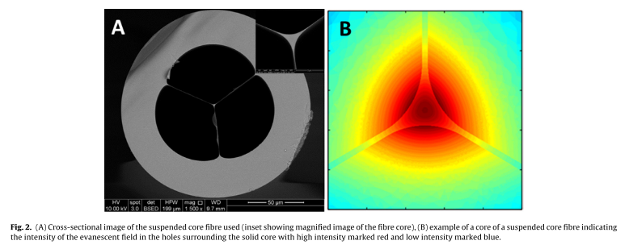
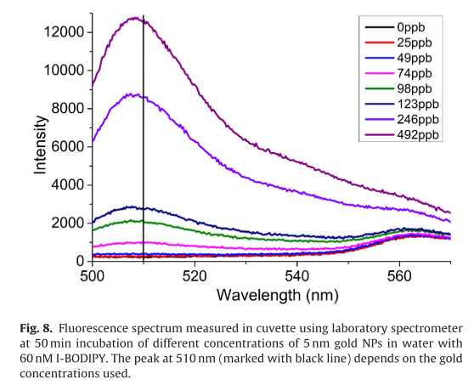
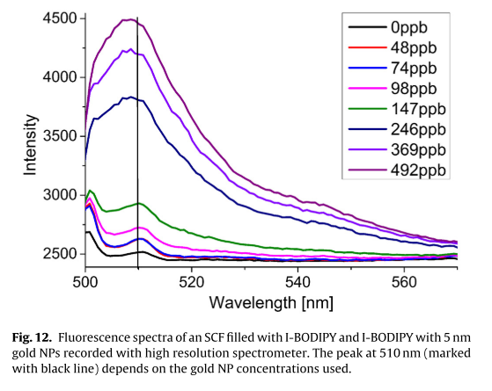
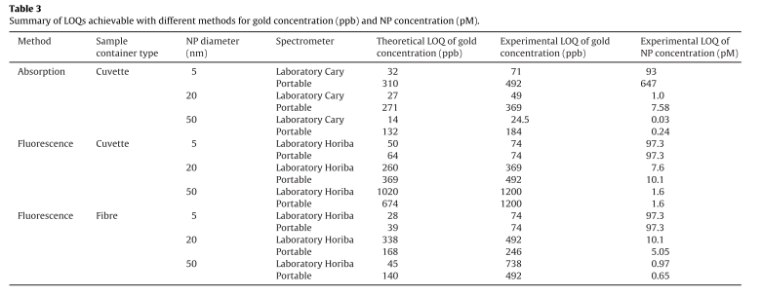
﻿Detection of gold nanoparticles with different sizes using absorption and fluorescence based method
Gold is daily used in jewellery, electrons, drug delivery, etc.
In this paper they foccused on the use of optical methods, as absorption and fluorescence, for detection of gold nanoparticles at concentrations of ppb order.
﻿Fluorophore I-BODIPY resulted in a fluorescence peak at 510 nm in the presence of gold NPs, whereby the intensity of the peak increased with increasing concentration of gold NPs in the solution The observation of such a fluorescence peak is consistent with the results reported by Park et al. for a similar BODIPY derivative.
Using the laboratory spectrometer and cuvette measurements, we investigated the impact of incubation time and BODIPY concentration on the fluorescence intensity and hence the LOQ of 5 nm, 20 nm and 50 nm gold NPs.
Fibre
The SCF made from silica was used for the fibre experiments since ir provides several advantages for sensing applications.
A SCF was used wu¡ith small core diameter of 1.5 µm with a cross-sectionalstructure (figure2).
The fibre core is surounded by three holes of 60 µm diameter.
﻿A. Zuber et al. / Sensors and Actuators B 227 (2016) 117–127

